Slide 1
Anonymizing social networks

Slide 2
What is Anonymizing ?
Anonymizing is a type of information sanitization whose intent is privacy protection
It is the process of removing personally identifiable information from data sets, so that the people whom the data describe remain anonymous.
Anonymization has been defined as a "process by which personal data is irreversibly
altered in such a way that a data subject can no longer be identified directly or indirectly

Slide 3
What is Graph Anonymization ?
Technique aimed at hiding private information about social network members when performing social network analysis. Node anonymization and edge perturbation are the two main graph anonymization techniques currently used.
Node Anonymization: Technique of hiding social network members’ identities by labeling the corresponding nodes with random identifiers (naïve anonymization)
Edge perturbation: Technique aimed at hiding the actual social network relationships by performing a set of random edge deletions/insertions in the network graph .

Slide 4
Model: Social Graph
Profiles + relationships with other users + exchange of information
Social networks model social relationships by graph structures using nodes and edges.
Nodes model individual social actors in a network, while edges model relationships between social actors.
Model: Social Graph Labels (type of edges, Nodes) Directed/undirected

Slide 5
Privacy Preserving Publishing
Why publishing?
Analysis of networks:
Study disease transmission, measure the influence of a publication, evaluate the networks resiliency to faults and attacks
A social network shows a set of individual related to sexual contacts and shared drug injections, analysis about how HIV spreads
Goal: Permit useful analysis yet avoid disclosing sensistive information

Slide 6
Privacy Preservation Issues
Models of Privacy
what pieces of information, we want to protect
Background Knowledge
what an adversary may know
Models of Utility
Use of the published data

Slide 7
Depth in Privacy Models
Examples of pieces of information:
Node existence: whether a target individual appears in the network or not.
Examples: a social network of millionaires or a disease infection network
Node properties: such as the degree of the node.
Sensitive node labels: labels can be divided into non‐sensitive vertex and sensitive similar to the case of relational data
For example, in a disease infection network, each individual may be associated with a sensitive label disease.

Slide 8
Models of Background Knowledge
Point of Adversary view
In general: the network structure around it
Attributes of nodes
Node degree
Link relationship
Neighborhood
Graph metrics

Slide 9
Models of Background Knowledge
What type of attacks do Adversary perform ?
Active: an adversary tries to compromise privacy by strategically creating new user accounts and links before the anonymized network is released, so that these new nodes and edges will then be present in the anonymized network.
Passive: try to learn the identities of nodes only after the anonymized network has been released

Slide 10
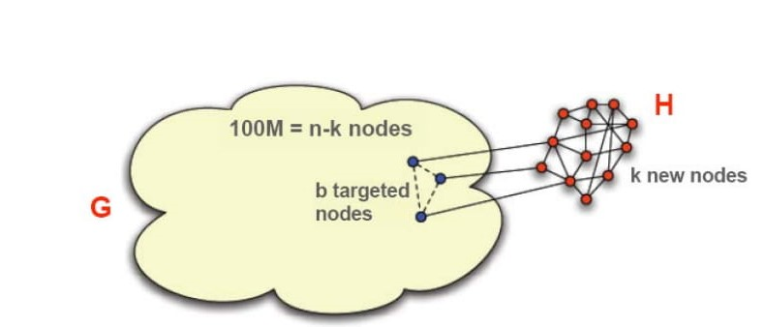
Active Attack
Before releasing the anonymized network G of n-k nodes, the attacker:
Choose a B target users.
Create a subgraph H containing k nodes.
Attach H to targeted node

Slide 11
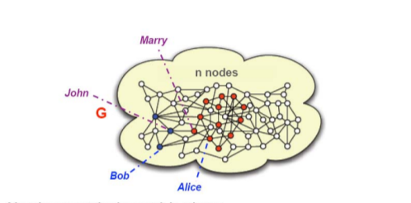
Passive attack
After the anonymized network is released
Find subgraph H in Graph
Follow edges from H to locate b target nodes and their true location G

Slide 12
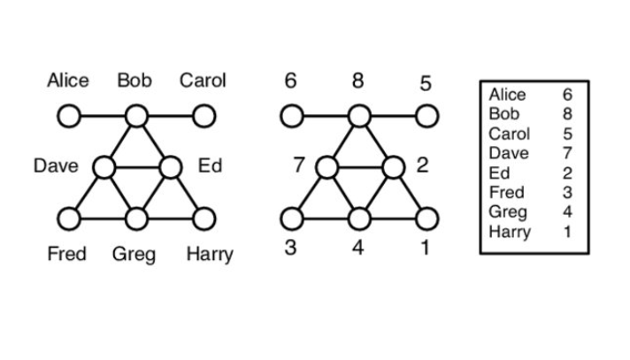
Anonymity through Structural Similarity
A strong form of structural similarity between nodes is automorphic equivalence
Example: Fred and Harry, but not Bob and Ed
An adversary —even with exhaustive knowledge of the structural position of a target node — cannot identify an individual beyond the set of entities to which it is automorphically equivalent.
We say that these nodes are structurally indistinguishable [nodes in the graph achieve anonymity by being “hidden in the crowd” of its automorphic class members.]

Slide 13
Anonymity through Structural Similarity
Some special graphs have large automorphic equivalence classes.
For example, in a complete graph, or in a graph which forms a ring, all nodes are automorphically equivalent.
In most graphs we expect to find small automorphism classes, likely to be insufficient for protection against re‐identification.
Automorphic equivalence is an extremely strong notion of structural similarity.

Slide 14
Vertex Refinement Queries
A class of queries, of increasing power, which report on the local structure of the graph around a node.
The weakest knowledge query, H0, simply returns the label of the node.
H1(x) returns the degree of x,
H2(x) returns the multiset of each neighbors’ degree,
Hi (x) returns the multiset of values which are the result of evaluating Hi‐1 on the nodes adjacent to x

Slide 15
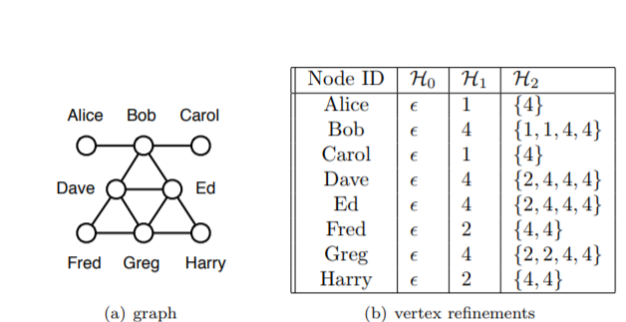
Vertex Refinement Queries

Slide 16
Subgraph Queries
Node refinement queries are a concise way to describe locally expanding structural queries.
H queries can describe arbitrarily large subgraphs around a node if that node is highly connected, thus the index of H query may be a coarse measure of the information learned
For example, if H1(x) = 100, the adversary learns about a large subgraph in G, whereas H1(y) = 2 provides much less information.
We measure the descriptive power of a query by counting the number of edges in the described subgraph; we refer to these as edge facts.

Slide 17
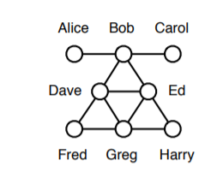
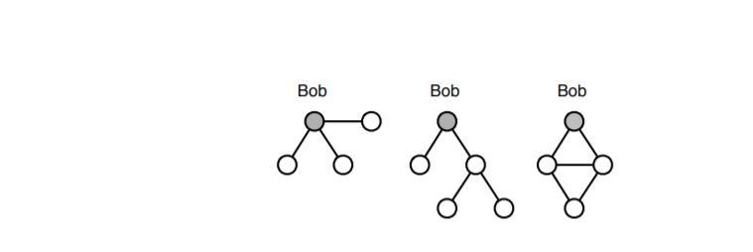
Subgraph Queries
Three subgraph queries centered around Bob.
The first simply asserts that Bob has (at least) three distinct neighbors, the second describes a tree of nodes near Bob, and the third relates nearby nodes in a subgraph. These informal query patterns use 3, 4, and 5 edge facts, respectively.

Slide 18
Dataset description and Metrics
Name: Les Miserables
Description: Les Miserables is a weighted network of characters in the novel Les Miserables
Nodes: 77 and Edges: 254
Degree: 6.5
Betweenness Centrality: 0.021
Closeness centrality: 0.389
Clustering Coeff: 0.573
Diameter: 5

Slide 19
naive anonymization
It is technique of changing node labels in to random identifiers
Naïve anonymization doesn’t provide complete protection
If an Adversary has external knowledge about graph he can re-identify the individual nodes in graph

Slide 20
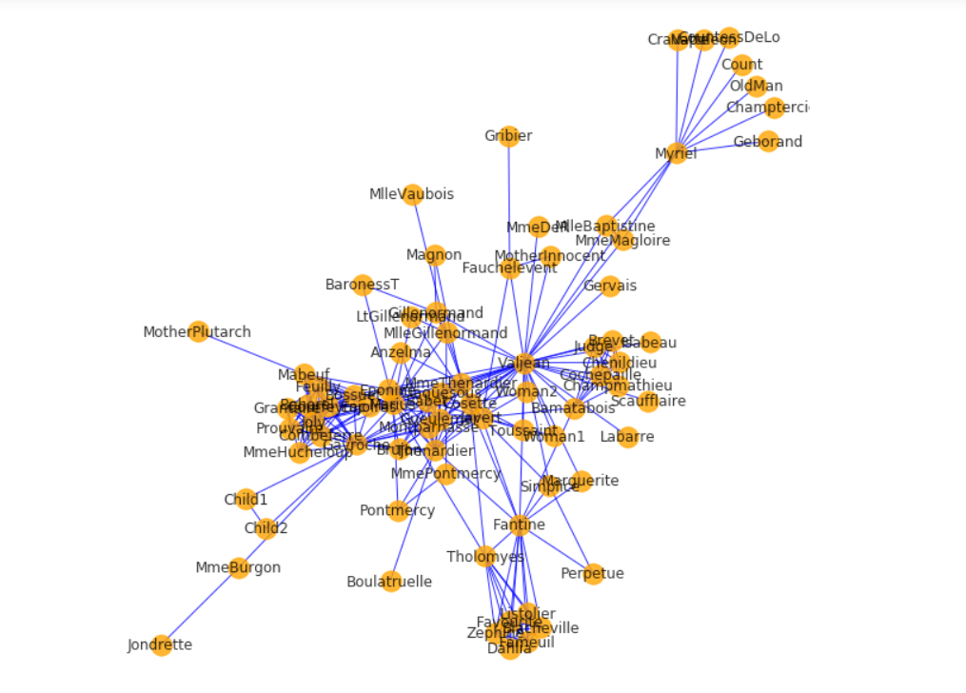
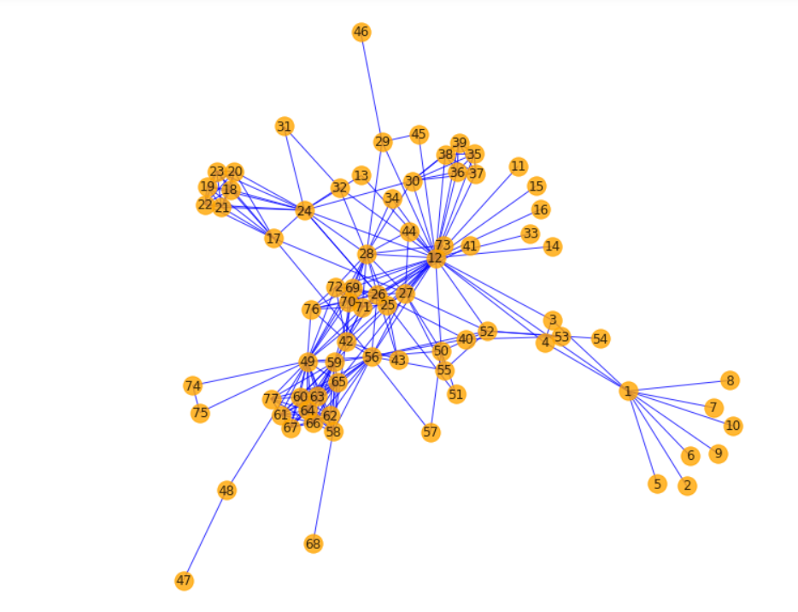
naive anonymization on dataset

Slide 21
Random Perturbation
A graph transformation technique which can protect against re-identification
Deleting edges randomly and insertion of edges randomly
Insertions are done uniformly from a set of non-existent edges of graph
Any node that would be a candidate for x under naive anonymization will also be a candidate under graph perturbation
As the perturbation increases the graph utility decreases
This technique leads to information loss

Slide 22
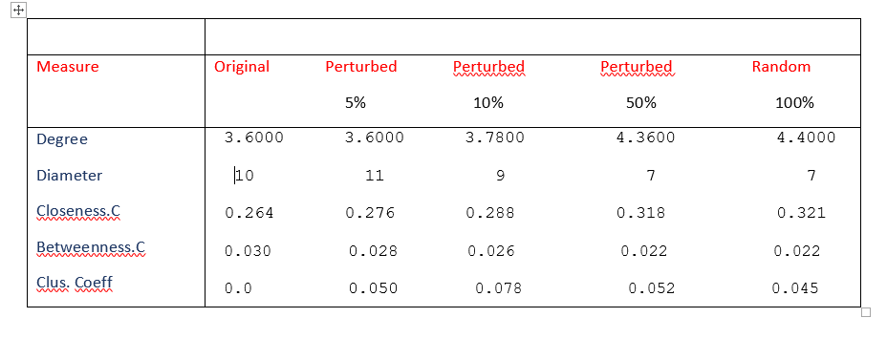
Random Perturbation on Random graph

Slide 23
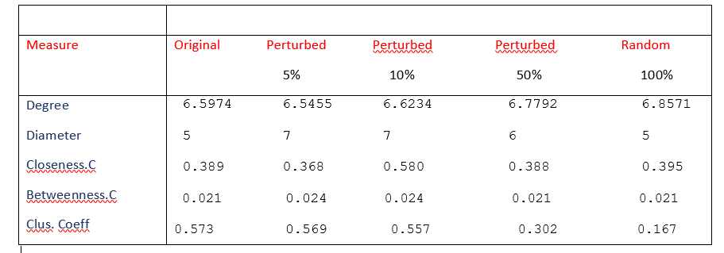
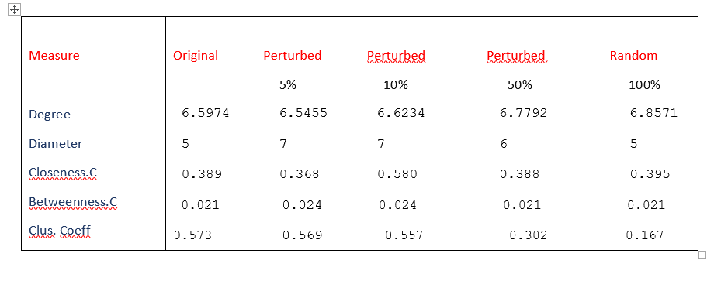
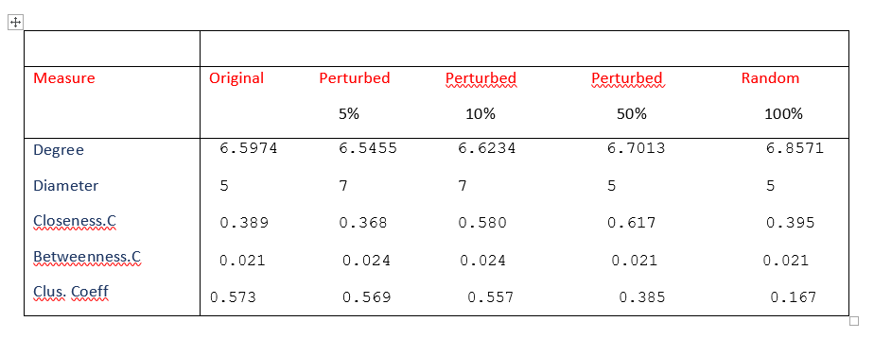
Random Perturbation on Dataset

Slide 24
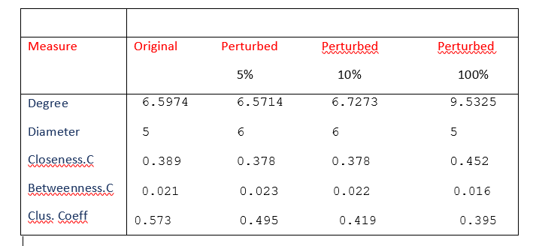
Manual Random Perturbation

Slide 25
conclusion
we formalize the threat of re-identification and various kinds of adversary external information
We focus on an adversary whose goal is to re-identify a known individual (e.g., Bob) in the naivelyanonymized graph.
We show that this techniques can significantly reduce the effectiveness of re-identification attacks by an adversary
Two problems with this techniques
Navie anonymization: This technique is not sufficient to provide Protection
Random perturbation: This technique provides best protection but there is a huge utility loss

Slide 26
Thank you

